Slide 1
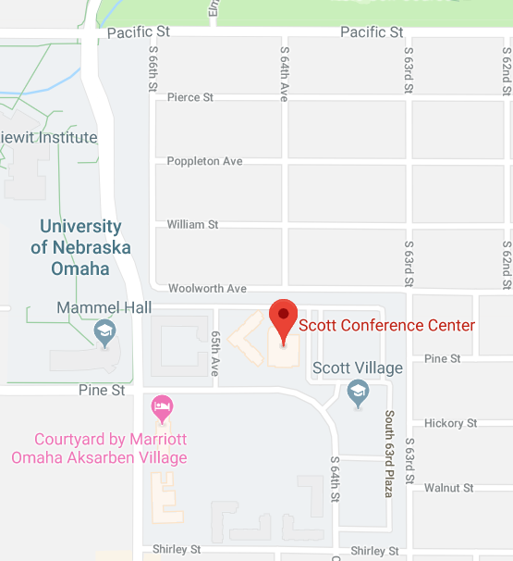
SAVE THE DATE GEO-Omaha 2021 Conference*
February 5, 2021
8:00 am -5:00 pm
GEO-Omaha 2021 Conference
7 guest speakers
Includes a 1-hour NE ASCE Geotechnical Ethics Course
Topic: “Professional Ethics in a Low Bid Environment”
Presenters: Mr. Vic Donald, with Geoprofessional Business Associateion (GBA)
Conference Registration CLICK HERE
LOCATION
Scott Conference Center
6450 Pine Street
Omaha, NE 68106
* This event is available for either in-person attendance or virtual attendance. Depending on the COVID-19 health and safety guidelines at the time of the event, a face covering and social distancing procedures may be required for in-person attendance. If gathering sizes are restricted to less than 25% of the rated occupancy rate, this event will be held virtually only.

